Slide 1
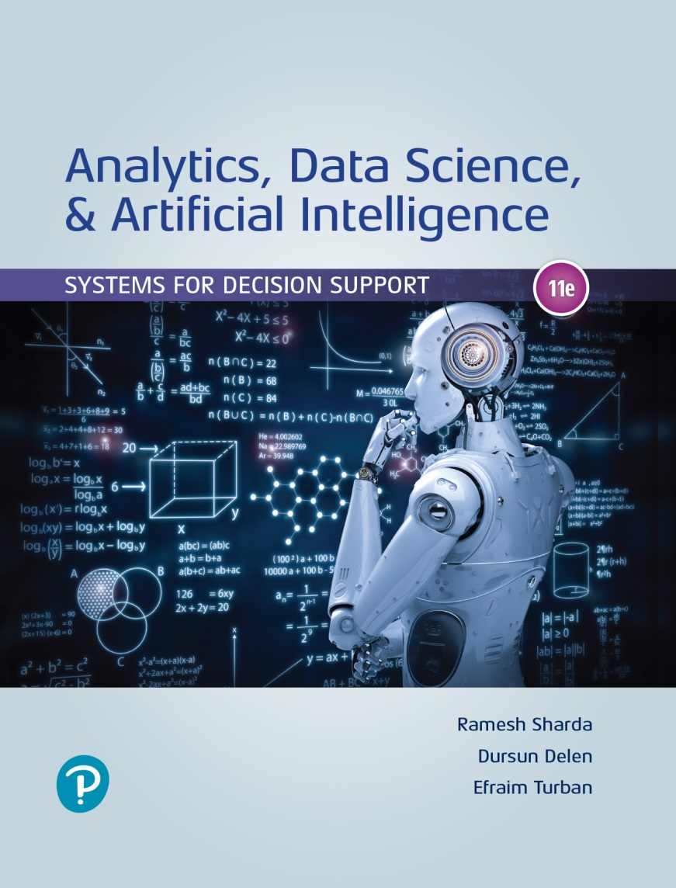
Analytics, Data Science and A I: Systems for Decision Support
Eleventh Edition
Chapter 2
Artificial Intelligence Concepts, Drivers, Major Technologies, and Business Applications
Slide in this Presentation Contain Hyperlinks. JAWS users should be able to get a list of links by using INSERT+F7
Copyright © 2020, 2015, 2011 Pearson Education, Inc. All Rights Reserved
Notes:
If this PowerPoint presentation contains mathematical equations, you may need to check that your computer has the following installed:
1) Math Type Plugin
2) Math Player (free versions available)
3) NVDA Reader (free versions available)

Slide 2
Learning Objectives
2.1 Understand the concepts of artificial intelligence (A I).
2.2 Become familiar with the drivers, capabilities, and benefits of A I.
2.3 Describe human and machine intelligence.
2.4 Describe the major A I technologies and some derivatives.
Notes:
Slide 2 is list of textbook LO numbers and statements

Slide 3
2.2 Introduction to Artificial Intelligence
One Possible Definition for artificial intelligence (A I)
The capabilities of a machine to imitate intelligent of human behavior.
AI is mainly concerned with:
The study of human thought process
The representation and duplication of those thought processes in machines

Slide 4
2.3 Human and Computer Intelligence
What is intelligence?
Types of intelligence:
Linguistic and verbal, logical, spatial, body/movement, musical, interpersonal, intrapersonal, naturalist
Intelligence is not a simple concept!
Content of intelligence
Reasoning, learning, logic, problem-solving, perception, and linguistic ability

Slide 5
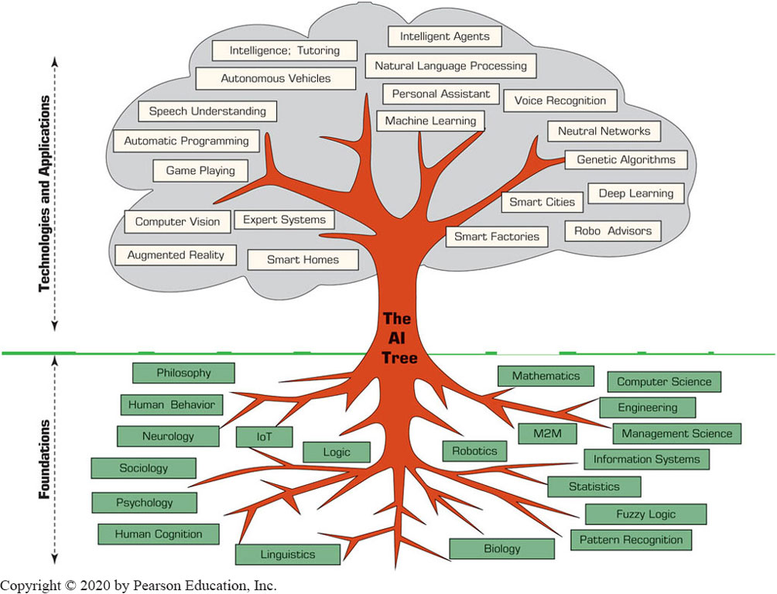
The Functionalities and Applications of A I

Slide 6
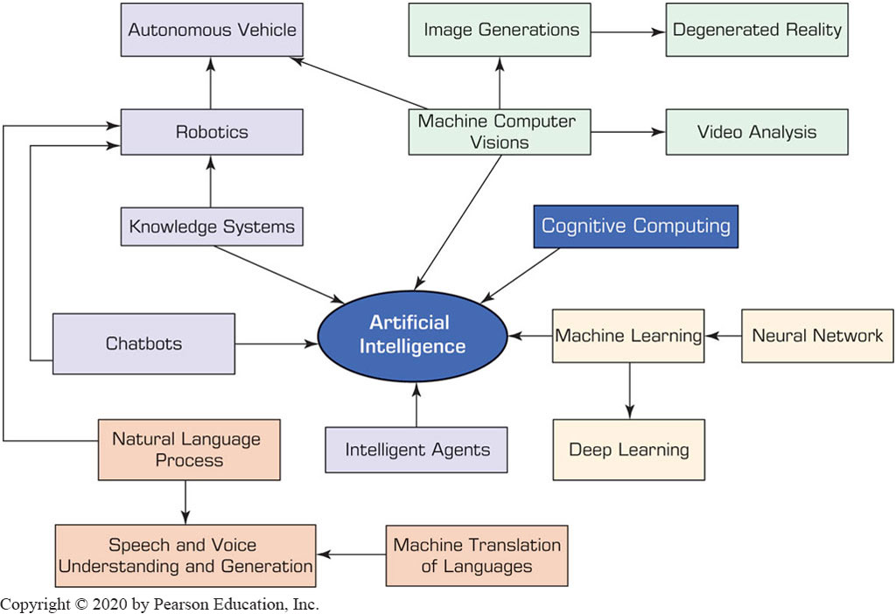
2.4 Major A I Technologies

Slide 7
2.4 Major A I Technologies & Drivers
Intelligent agents (IA)
An intelligent agent (IA) is an autonomous, small computer program that acts upon changing environments as directed by stored knowledge.
Help human agents in achieving specific goals related to the changes in the surrounding environment.
Intelligent agents may learn by using the expanding knowledge embedded in them.
Examples:
Virus detection program, recommending product, making price recommendations.

Slide 8
Major A I Technologies & Drivers
2.4.2 Machine learning (ML)
Teaching computers to learn from examples and large amounts of data, and new situations.
Scientists teach computers to identify patterns and make connections by showing them a large volume of examples and related data.
Allow the system to monitor and sense their environmental activities and adjust their behavior as needed.
Learn based on data coming from sensors, databases, and other sources.
Can be used to make predictions, recognize patterns, predict performance.
Examples: credit card fraud detection, improving customer loyalty and retention, hiring the right people, predictive maintenance, retail shelf analysis.

Slide 9
Major A I Technologies & Drivers
2.4.2 Deep learning (DL)
A subset of machine learning
Tries to mimic how the human brain works
Uses artificial neural networks
Play a major role in dealing with complex applications that regular machine learning cannot handle.
Deliver systems that not only think but also keep learning, enabling self-direction based on fresh data that flaw in (big data).
As long as new data arrive, learning occurs.
Deep learning is a key technology in autonomous vehicles by helping to interpret road signs and road obstacles.
DL is most useful in real-time interactive applications in the areas of vision recognition, scene recognition, robotics, and speech and voice processing.

Slide 10
Major A I Technologies & Drivers
2.4.3 Machine and computer vision
Technology and methods used to provide image-based automated inspections and analysis for applications such as robot guides, process controls, automated vehicles, and inspections.
An important tool for the optimization of production and robotic processes.
Industrial camera is important tool for capturing, storing, and archiving images/videos that can then be processed by humans or computers.
Lowers cost of performing repetitive tasks that are cumbersome and possible make the human eyes tired.
Example application (objects counter):
https://youtu.be/RcUUM3mLK7Q

Slide 11
Major A I Technologies & Drivers
2.4.3 Video analytics
Applying computer vision techniques to videos
Enables the recognition of patterns, and potential events.
Example: predicting potential trouble behavior in certain situations at major human gatherings.

Slide 12
Major A I Technologies & Drivers
2.4.4 Robotic systems
A robot is an electromechanical device that is guided by a computer program to perform manual and/or mental tasks.
An intelligent robot has a sensory apparatus such as a camera that collects information about the robot’s surroundings and its operations.
Combines with machine and deep learning, can perform many tasks including learning from situations.
Possible types of robots:
Industrial robots [for manufacturing]
Service robots
Example application (Walmart stock scanning robot):
https://youtu.be/XZBSR_3rvxg
In ecommerce (shopbots):
https://youtu.be/ssZ_8cqfBlE

Slide 13
Major A I Technologies & Drivers
2.4.5 Natural language processing (NLP)
A technology that allows people to communicate with a computer in their native language.
Language can be in written text or voice (speech).
NLP has two subfields:
Natural language understanding
Natural language generation
Sample applications:
Speech (voice) understanding by automated call centers
Machine translation of human languages
Example: https://youtu.be/Pk6a6mvOoJA

Slide 14
Major A I Technologies & Drivers
2.4.6 Knowledge & Expert Systems & Recommenders
Computer programs that store knowledge, which their applications use to generate expert advice, give recommendations, and/or perform problem solving.
Knowledge sourced intelligent systems
Knowledge acquisition
Identifying experts
Extracting and structuring knowledge (observing, interviewing, scenario building, and discussing).
Needs trained knowledge engineers for knowledge acquisitions and building system.
Knowledge representation
How will the knowledge be organized and stored
Simple form is in questions & answers (Q&A).
Reasoning from knowledge
Process users’ requests and provides answers.

Slide 15
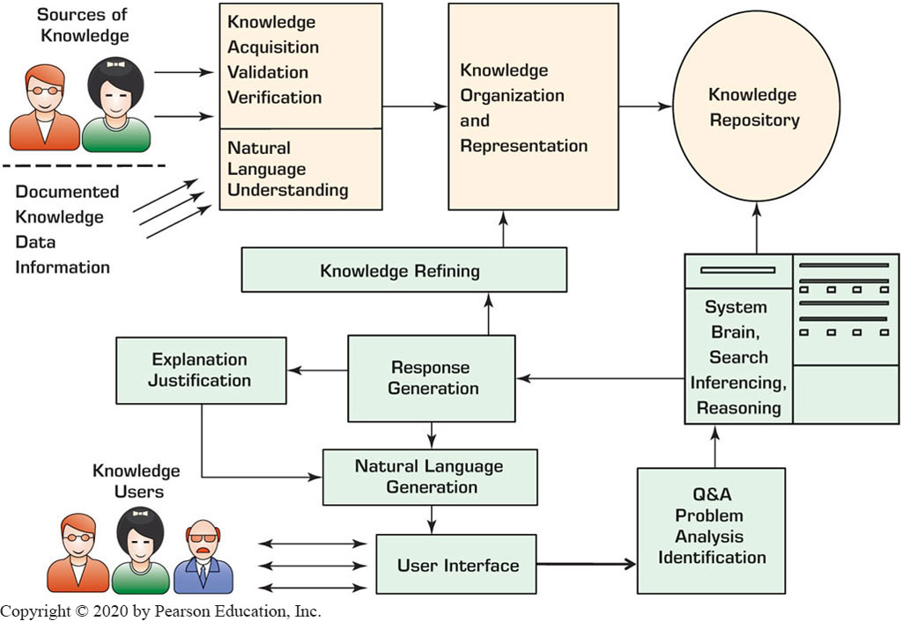
Major A I Technologies & Drivers
Expert Systems

Slide 16
Major A I Technologies & Drivers
2.4.7 Chatbots
A chatbot is a type of a robot, which is also a knowledge-based system.
Is a conversational robot that is used for chatting with people
Text or voice
Can be:
Intelligent agents for retrieving information
Personal assistants that provide advice
Are equipped with NLP that enables conversations in natural human languages.
Example: Google Assistant:
https://youtu.be/FPfQMVf4vwQ
https://youtu.be/-qCanuYrR0g

Slide 17
Major A I Technologies & Drivers
2.4.8 Emerging AI Technologies (1)
Cognitive computing
The application of knowledge derived from cognitive science (the study of human brain) and CS theories to simulate human thought processes.
Uses: self-learning algorithms, pattern recognition, NLP, machine vision, etc.
Example: IBM Watson

Slide 18
Major A I Technologies & Drivers
2.4.8 Emerging AI Technologies (2)
Augmented reality
Augmentation: integration of digital information within the user environment in real time, providing people real-world interactive experience with the environment.
Uses: machine vision, scene recognition, gesture recognition, in general, data captured by sensors.
Example: Google Maps ( https://youtu.be/4F0gFpzsYLM )

Slide 19
A I in Human Resource Management (1 of 2)
Recruitment – talent acquisition
LinkedIn uses AI algorithms to suggest matches to both recruiters and job seekers.
removes unconscious biases and prejudices of humans.
Training – A I facilitates training
Chatbots can be used as a source of knowledge to answer learners’ queries.
AI can be used to test progress, and personalize online teaching for individuals

Slide 20
A I in Human Resource Management (2 of 2)
Performance assessment (evaluation)
Breaking work into many small components and by measuring the performance of each employee and team on each component.
Performance is compared to objectives, which are provided to employees and teams.
Retention – eliminating attrition
Predicting attrition way ahead of time to eliminate loss of talent

Slide 21
A I in Marketing & Advertising (1 of 2)
Product and personal recommendations
Smart search engines (e.g., Google’s Rank AI system)
Fraud and data breaches detection
Social semantics (sentiment analysis & voice recognition)
Web site design
Producer pricing (predictive analysis, dynamic pricing, forecasting)

Slide 22
A I in Marketing & Advertising (2 of 2)
Predictive customer service options
Ad targeting
Speech recognition
Language translation
Customer segmentation
Sales forecasting
Content generation

Slide 23
A I in Production-Operation Management
A I in manufacturing
Automation for compliance and cost reduction
React quicker and more effectively (agility)
Implementation model
Streamlining processes, smart outsourcing, work automation, improving customer experience
Intelligent factories
Logistic and transportation
Example: D H L supply-chain

Slide 24

Copyright
This work is protected by United States copyright laws and is provided solely for the use of instructors in teaching their courses and assessing student learning. Dissemination or sale of any part of this work (including on the World Wide Web) will destroy the integrity of the work and is not permitted. The work and materials from it should never be made available to students except by instructors using the accompanying text in their classes. All recipients of this work are expected to abide by these restrictions and to honor the intended pedagogical purposes and the needs of other instructors who rely on these materials.

